Slide 1





Senior Design
25-Feb-2011
ICARUS
David Gitz, EE
FAST Robotics CEO
ICARUS Lead Engineer
Notes:
Speaker Background

Slide 2
Topics
Paperwork
FAST Robotics Team
System Description
Capabilities and Technologies
System Specifications
Landing Pad Overview
Landing Pad Sub-Systems
Requirements
Tools

Slide 3

Non-Disclosure Policy and Agreement
Invention Assignment
Media Consent

Slide 4
Core Team
David Gitz Electrical Engineer ICARUS Lead Engineer FAST Robotics CEO Ben Wasson Masters Student FAST Robotics Business Manager Amy Welling FAST Robotics Accounting Director Michael Welling PhD Candidate ICARUS Systems Engineer | Arjun Sadahalli PhD Candidate ICARUS Vehicle Support Engineer Ed Langenderfer Mechanical Engineer ICARUS Vehicle Fabrication Engineer James Chaklos Masters Student ICARUS Test-Stand Engineer

Slide 5
Satellite Teams
Washington University UAV Team
SIU-Carbondale Control Systems Lab
Boeing Volunteers

Slide 6
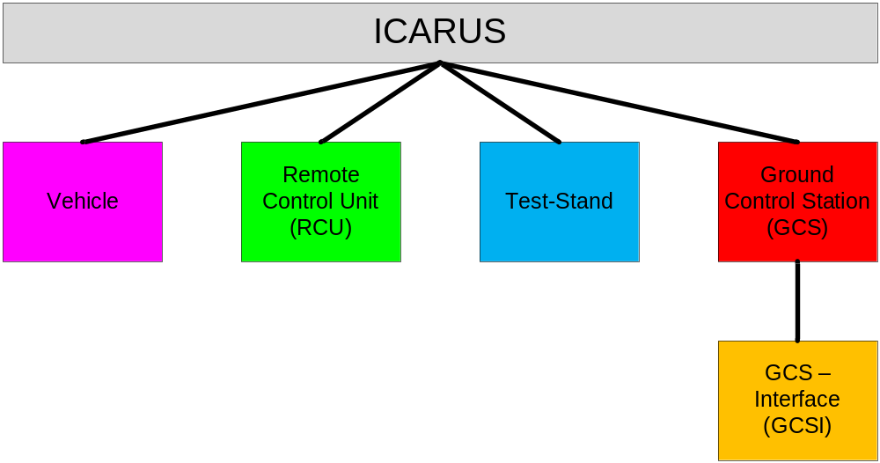
System Description

Slide 7
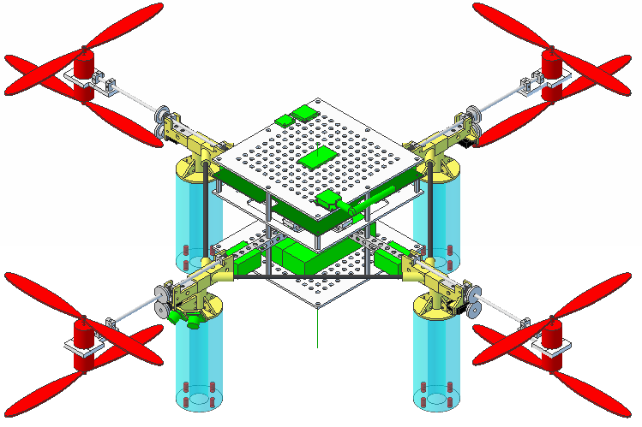
Vehicle

Slide 8
Vehicle Specifications
Sensors: 3-Axis Accelerometer, 3-Axis Gyroscope, 3-Axis Magnetometer (INU), Digital Compass, Altimeter, GPS, 7 Ultrasonic Sensors
Power: 8 Brushless DC 200 Watt Motors, 4 Micro Servo’s, 2 Lithium-Poly 11.1V 5 Amp-Hours Batteries, 8 18A Electronic Speed Controllers, 5V and 3.3V Linear Voltage Regulators.
Control: SoM Controller (Primary), Propeller Controller (Secondary), custom PCB.
Communications: Xbee Radio for Command/Control, Video Transmitter, Wi-Fi.
Fabrication: ~50% COTS, ~50% produced by MakerBot/Ponoku.

Slide 9
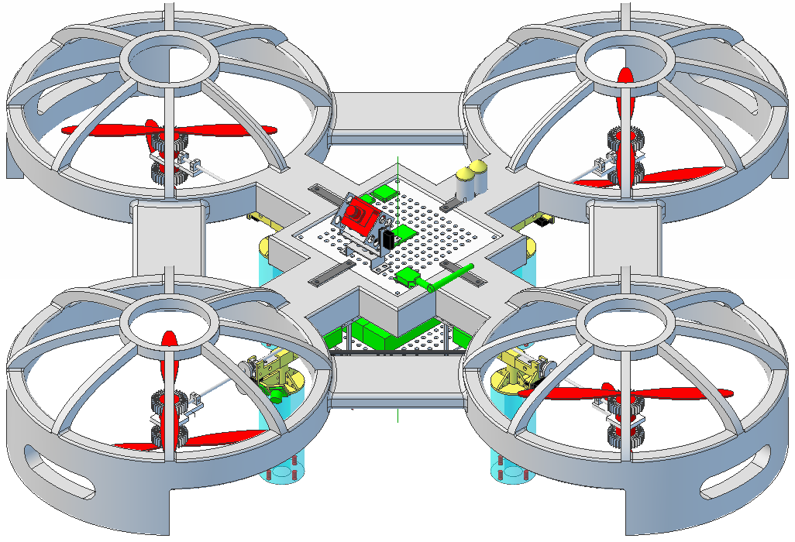
Vehicle w/ Prototype Systems

Slide 10
Capabilities
Capabilities - Planned
Manual Control via RCU or GCS | Simple Calibration and Testing via Test-Stand
Limited Autonomous Navigation via RCU | Error Display on RCU and GCS
Extended Autonomous Navigation via GCS | Force-Feedback on RCU
Automatic Takeoff, Hover and Landing | Vehicle Health Reporting
Capabilities - Future
Real-Time Video Transmission to GCS | Image Capture
Wireless airborne programming | Advanced Hover modes
Vehicle Status Audio via RCU | Extended Range
Configurable Payloads | Terrain Following
Extended Flight Duration | Obstacle Avoidance
Swarm Autonomy | Vehicle Status - Audio

Slide 11
Technologies
Technologies - Planned
Command/Control Network Monitoring | Inertial Navigation Unit (INU) w/ Altitude and Heading Reference System (AHRS)
Power Management | Primary/Secondary Controller Implementation
Waypoint Navigation | Communications Protocol
Technologies - Future
3d Feedback | Audio Commands
Automatic Landing Pad | Cellular Network
Cel-Phone Control | Co-Axial Rotors
Data Storage | GCS Interface (MATLAB)
JAUS Interoperability | Motor Heat Dissipation
R/C Control | RCU Testing Software
Recovery System | Tilt Rotors
Satellite Communications | Simultaneous Localization and Mapping (SLAM)
Target Detection | Wireless Charging

Slide 12

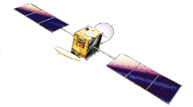

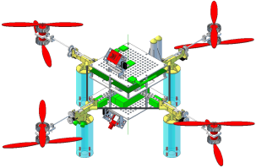
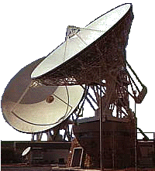

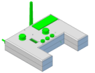
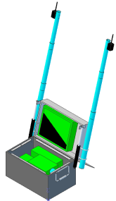
GPS Satellite
InmarSat Satellite
Command/Control
Video
GPS
Services
Diagram
Vehicle
WAN
Cellular Network
Ground Entry Point
RCU
GCS

Slide 13
System Specifications
Range: ~1.5 km LOS (~3km with Xbee Mesh Network)
Duration:
  Vehicle: ~12 min (100% Throttle) , ~20 min (Hover)
  RCU: ~4-6 hrs
  GCS: ~4-6 hrs (including field charging Vehicle)
Speed: ~2 - 4 kph
Weight: ~5.5 lbs
Size: 48” x 48” x 10.5”
Propeller Rotation: Max: 3,000 RPM
Vertical Thrust: ~7.8 lbs
Notes:
*Educated Guesses

Slide 14

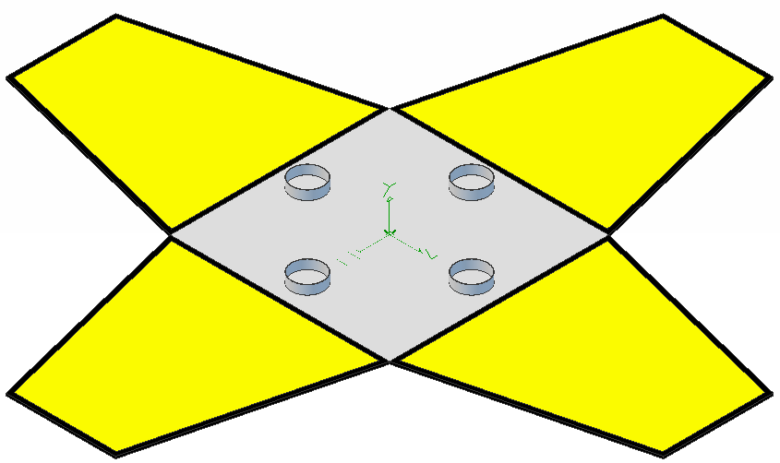
Portable system to autonomously recharge Vehicle in the field
  Current energy storage devices limit flight times of Quad-Rotors – maximum is around 1 hr flight time
  Autonomous recharge systems can significantly increase length and type of mission capability

Slide 15

Frame
Power
Guidance
Control and Communications

Slide 16

Portable, Robust
  Portable: Easily transportable by operators in the field
  Robust: Able to at least operate in any weather condition that the Vehicle is capable of operating in.
Suggestions:
  Weather protect any sensitive devices

Slide 17

Collection, Storage, Delivery
  Collection: Solar Panels
  Storage: Li-Poly, Ni-Mh, or Lead SLA Batteries
  Delivery: Wireless power transfer to Vehicle
Required Modifications to Vehicle
  Hardware/Software for wireless power transfer

Slide 18

Guides Vehicle onto Landing Pad
  Uses Sensors and Hardware mounted on Vehicle to provide Vehicle location relative to Landing Pad
  Communicates movement commands to Vehicle
Required Modifications to Vehicle
  Hardware/Software for Vehicle Indicators
Suggestions:
  Install light source centrally mounted on bottom of Vehicle. CMUcam2 tracks color blobs and outputs (serial) target center. Command Vehicle to move using x,y,z coordinates of target center

Slide 19

Requirements:
  Follow ICARUS Communication Protocol explicitly
  Use XBee-PRO Transciever (or compatible option)

Slide 20

Requirements:
  Features: Targets and Goals
  Targets: Required for minimum mission capability
  Goals: Optional to increase mission capability

Slide 21

Required:
  Design Documentation
  Electrical Schematics and PCB Files
  User Manual
  Specifications
  Prototype
Optional:
  Working Prototype

Slide 22

COTS Hardware
SVN Repository
  Online File storage system to promote collaboration and continuity
Software
Project Management
ICARUS Communications Protocol

Slide 23

Questions?
Contact:
  David Gitz: david.gitz@fastrobotics.com
  Ben Wasson: ben.wasson@fastrobotics.com

